Slide 1
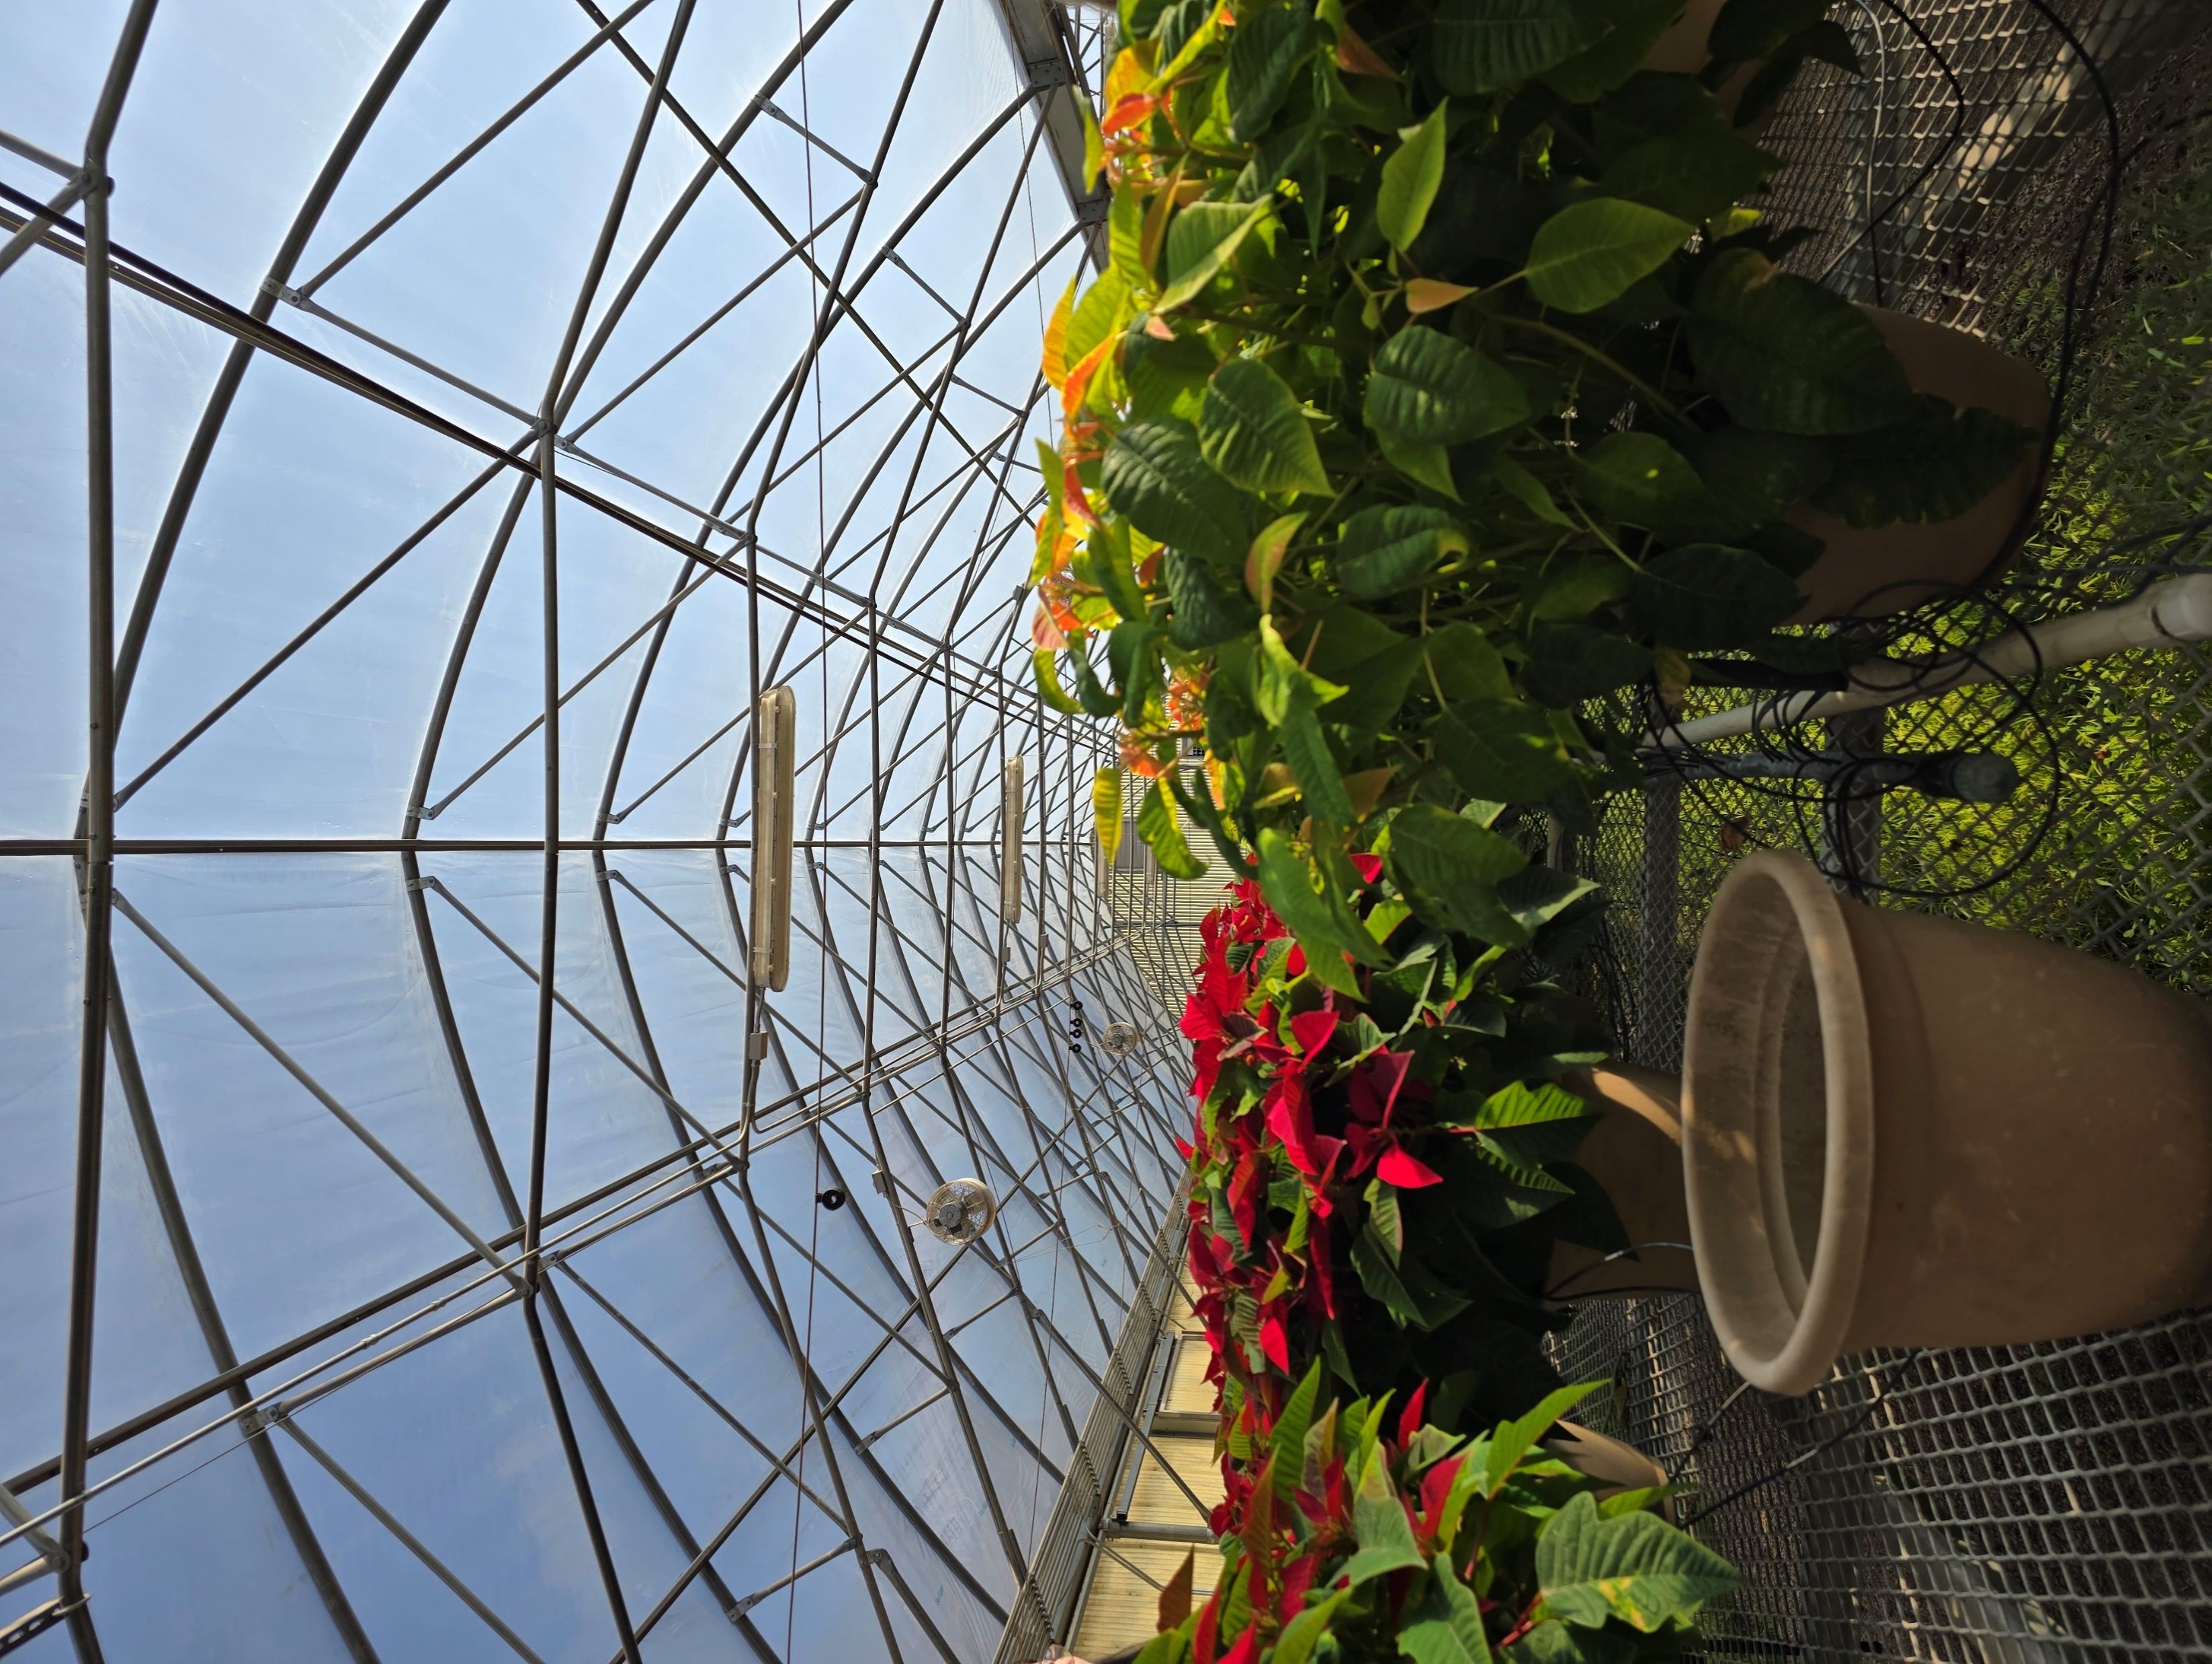


Exploring the Impacts of Indoor Farming
Through The Internet of Things
Powered by a collaboration between CNM Ingenuity, regional tribal communities, and The University of New Mexico

Slide 2
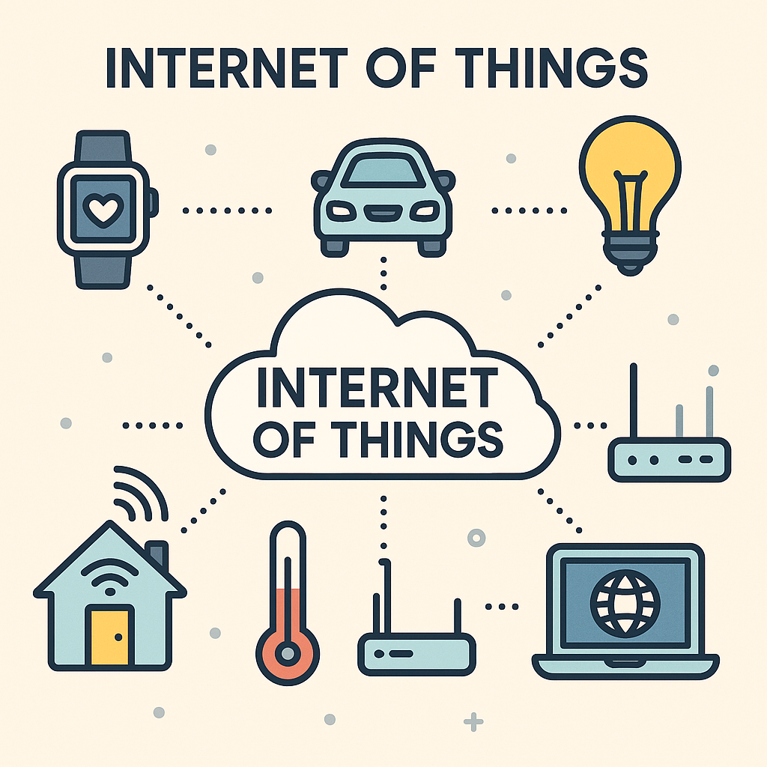
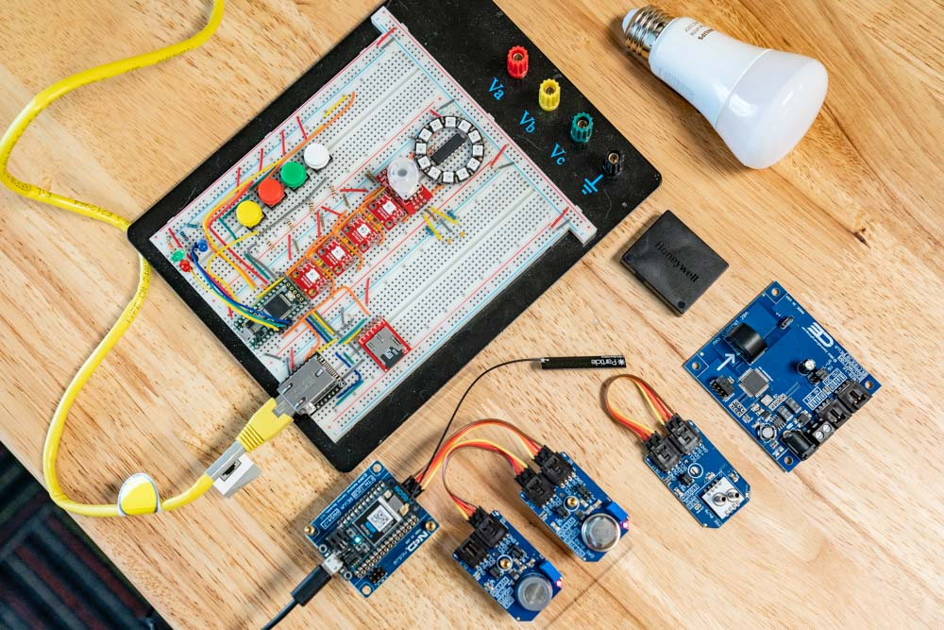
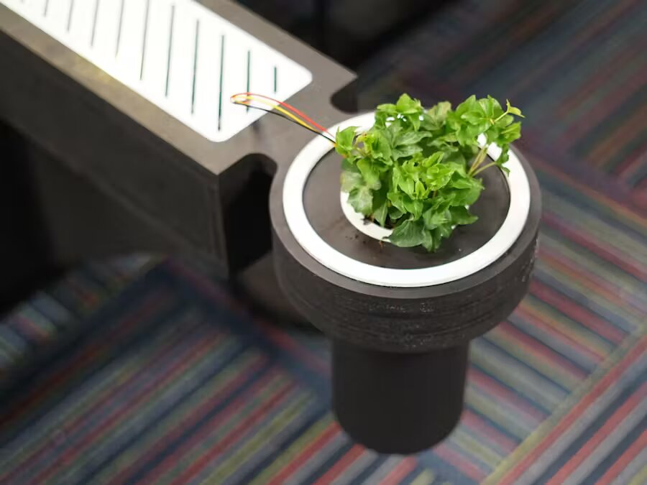
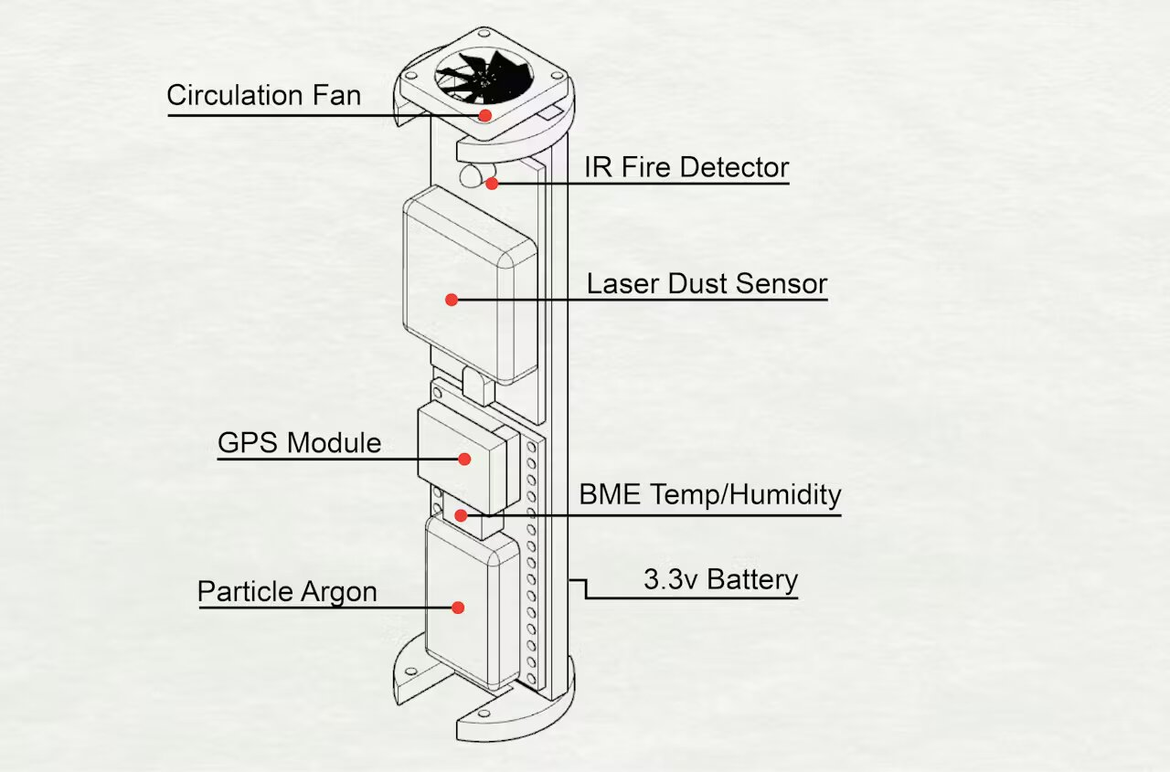
What is the Internet of Things?
A way to connect everyday objects—like your fridge, car, lights, or even a thermostat to the internet, so they can collect and share information.
Central New Mexico Community College(CNM) Deep Dive Coding boasts A 10-week full-time, immersive bootcamp where learners create and code smart connected devices that respond to their environment and collect and track data about those conditions and responses.

Slide 3
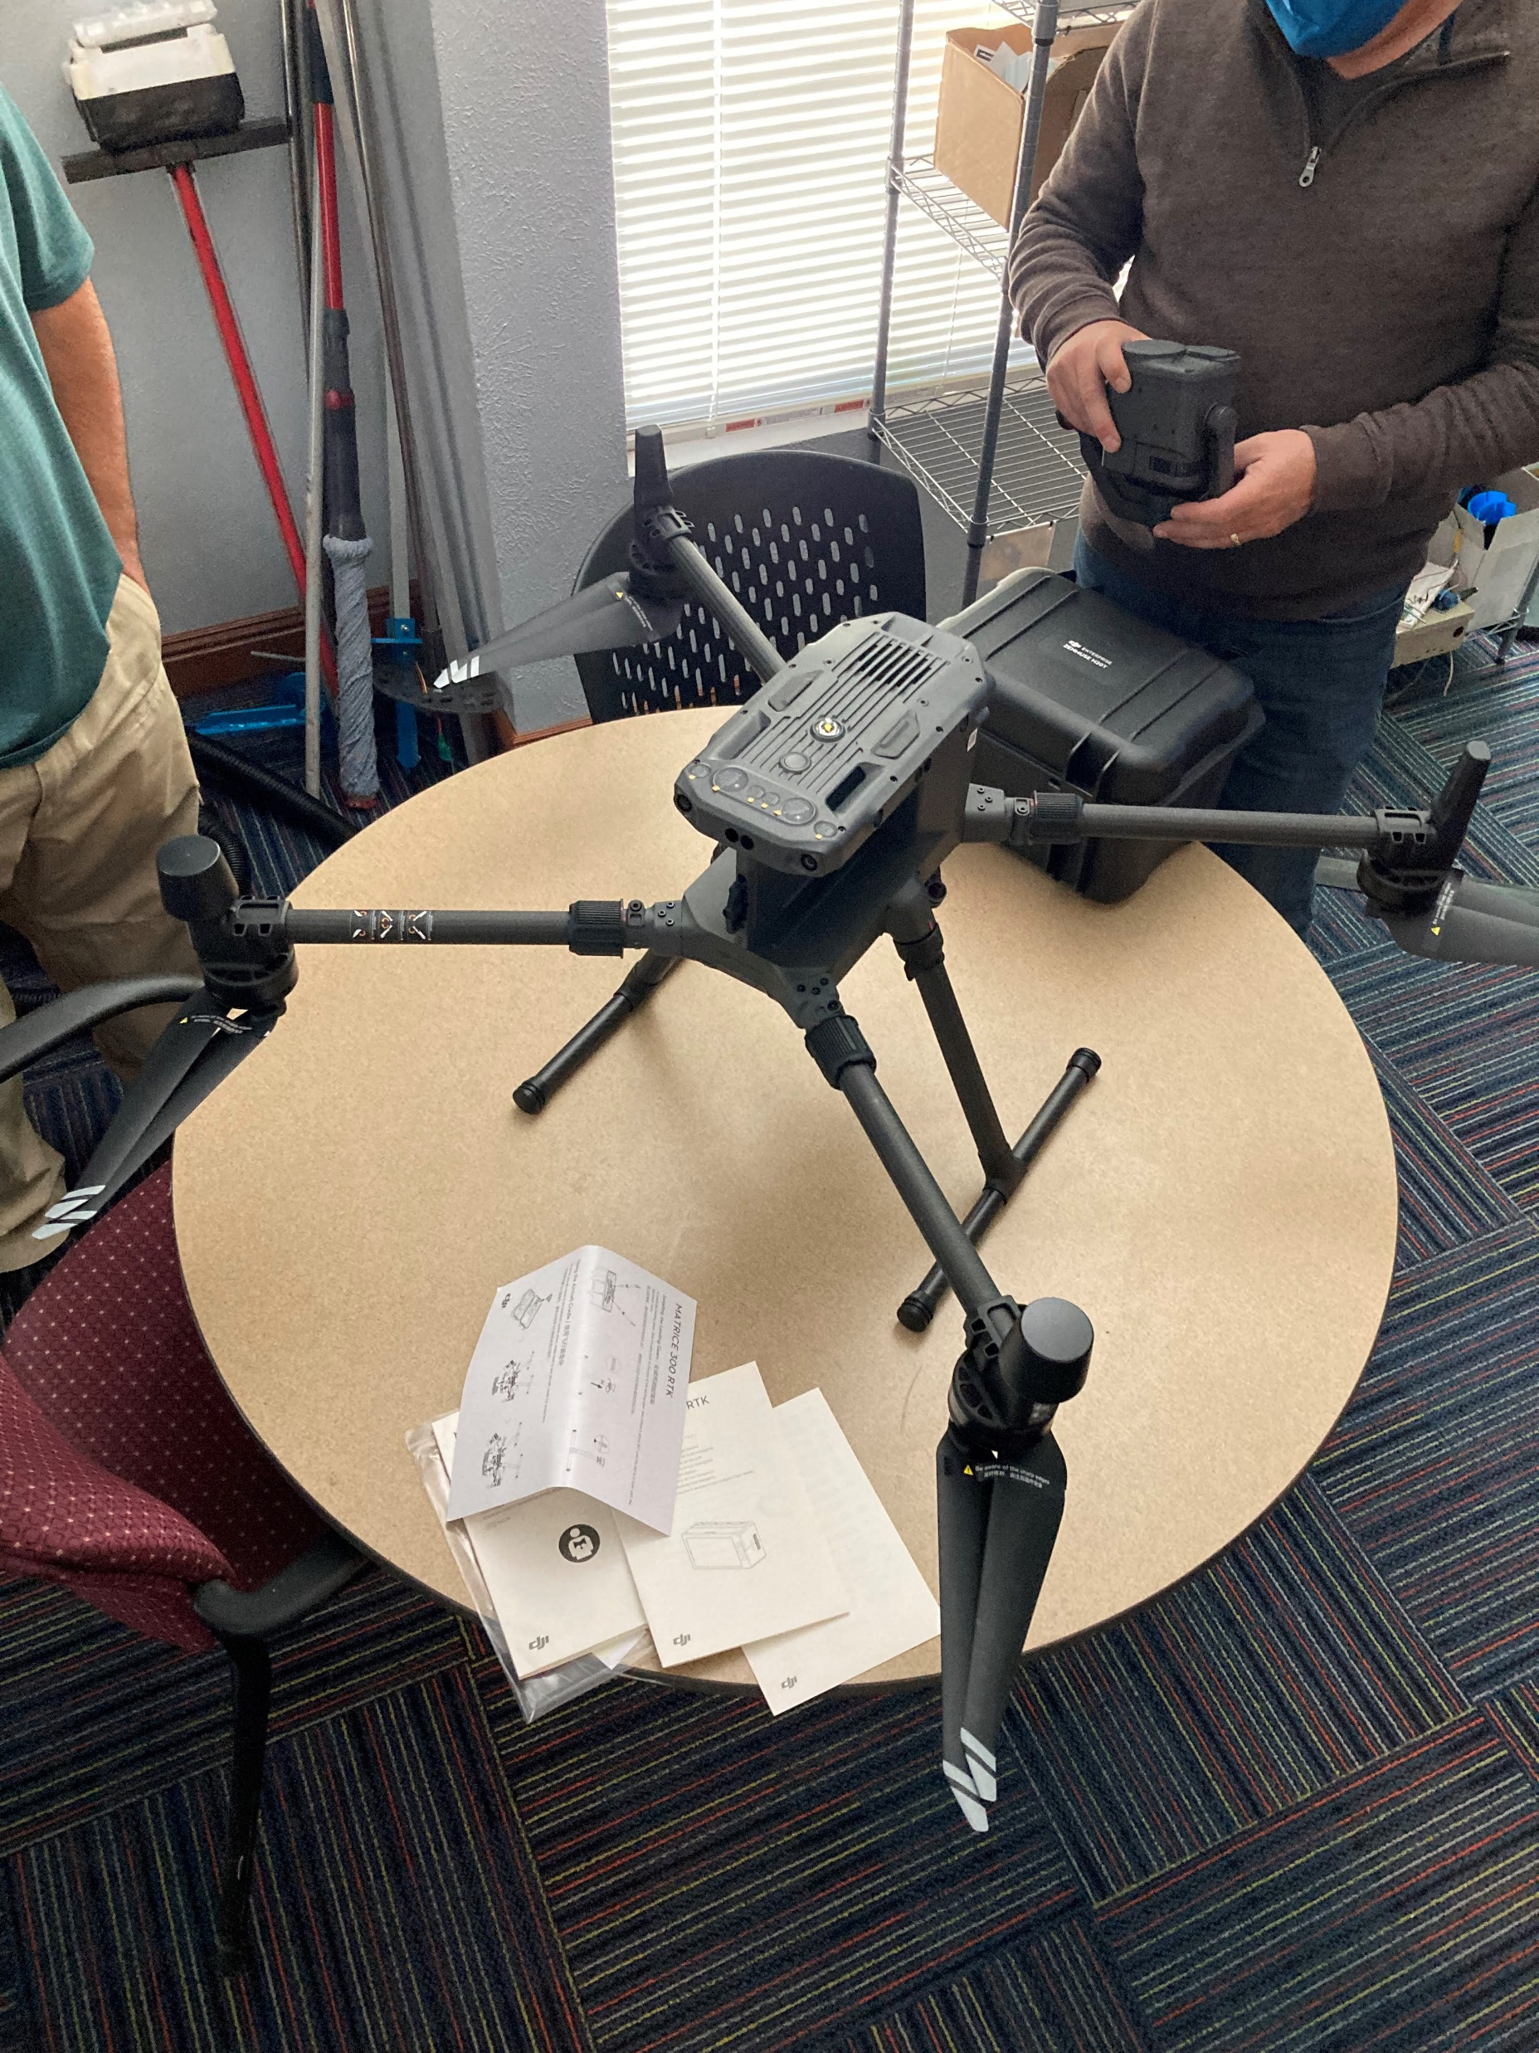
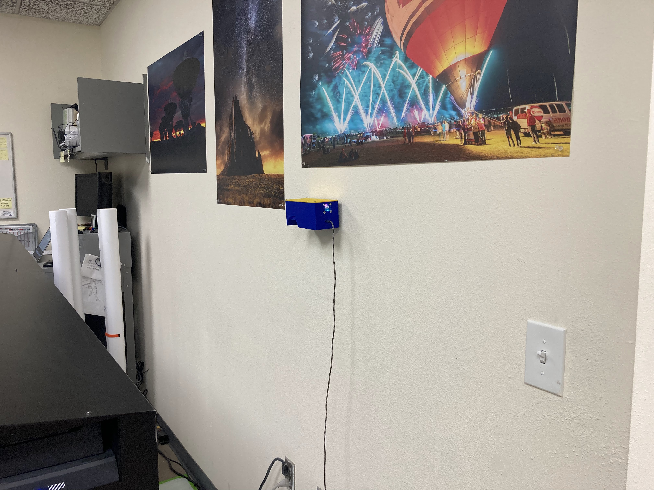
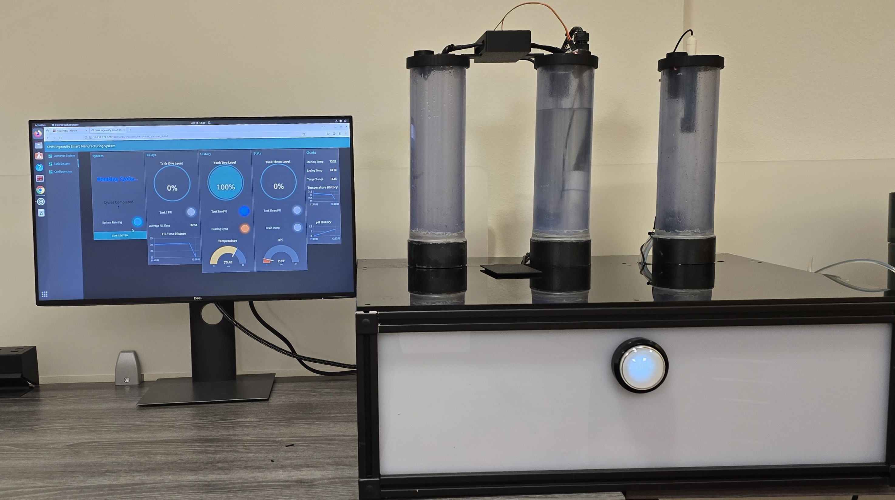
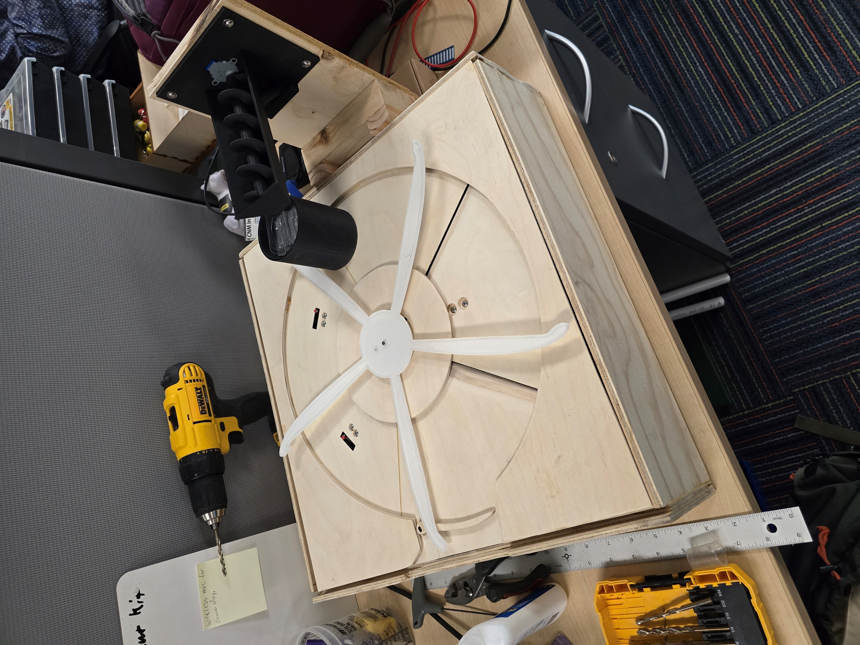
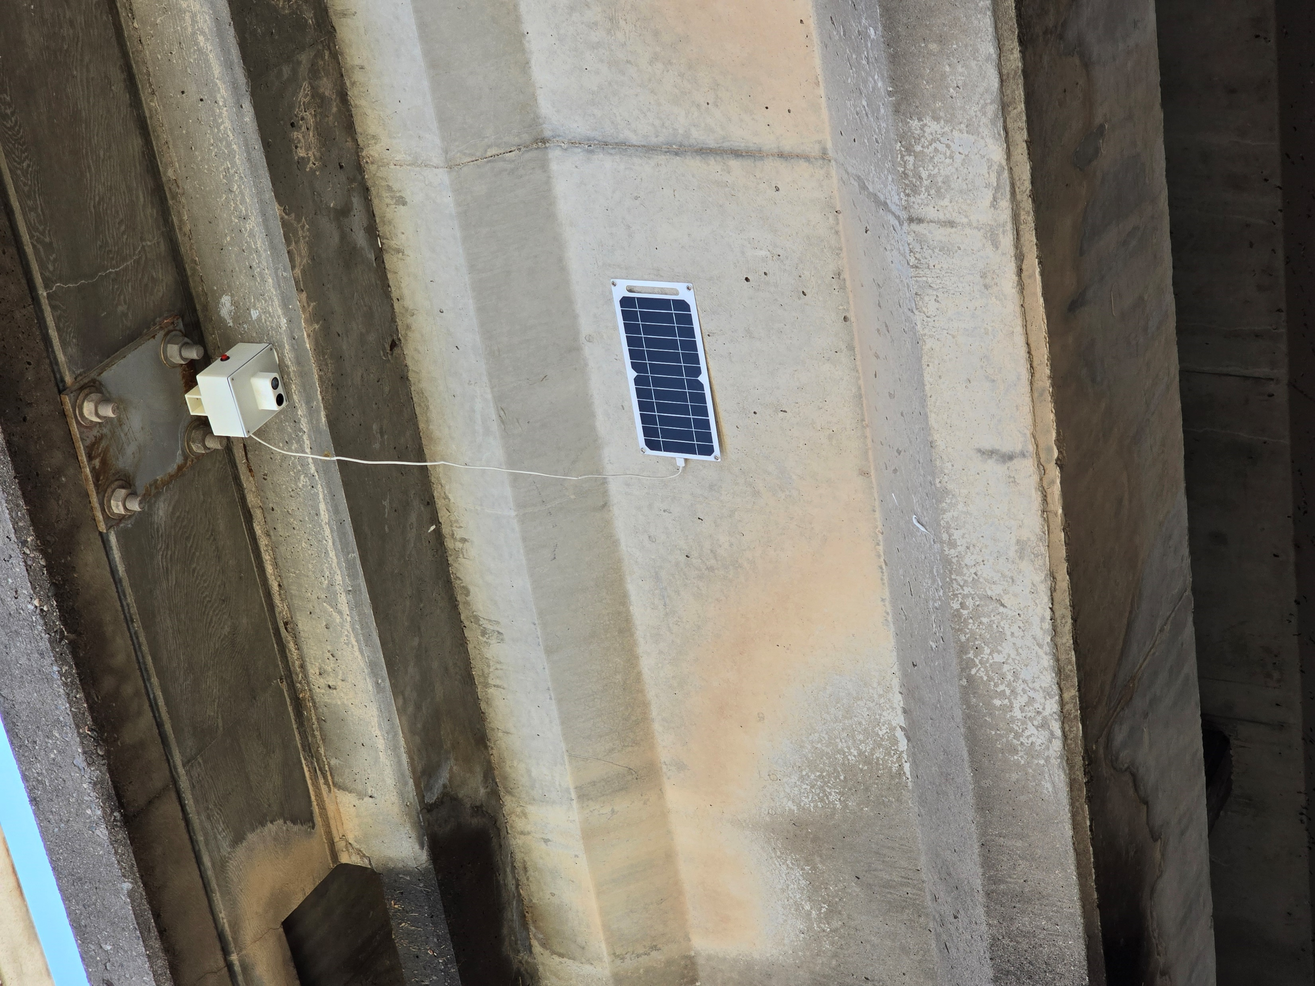
CNM Ingenuity’s Technology Solutions Lab
CNM's Technology Solutions Lab,(TSL), is a business run by CNM Ingenuity that provides technology solutions for local companies and pays CNM Deep Dive graduates while they gain real-world work experience.
Partners
City of ABQ | Century Sign Builders | Mandy’s Farm | ABQ Biopark | New Mexico Manufacturing Extension Partnership | The University Of New Mexico

Slide 4
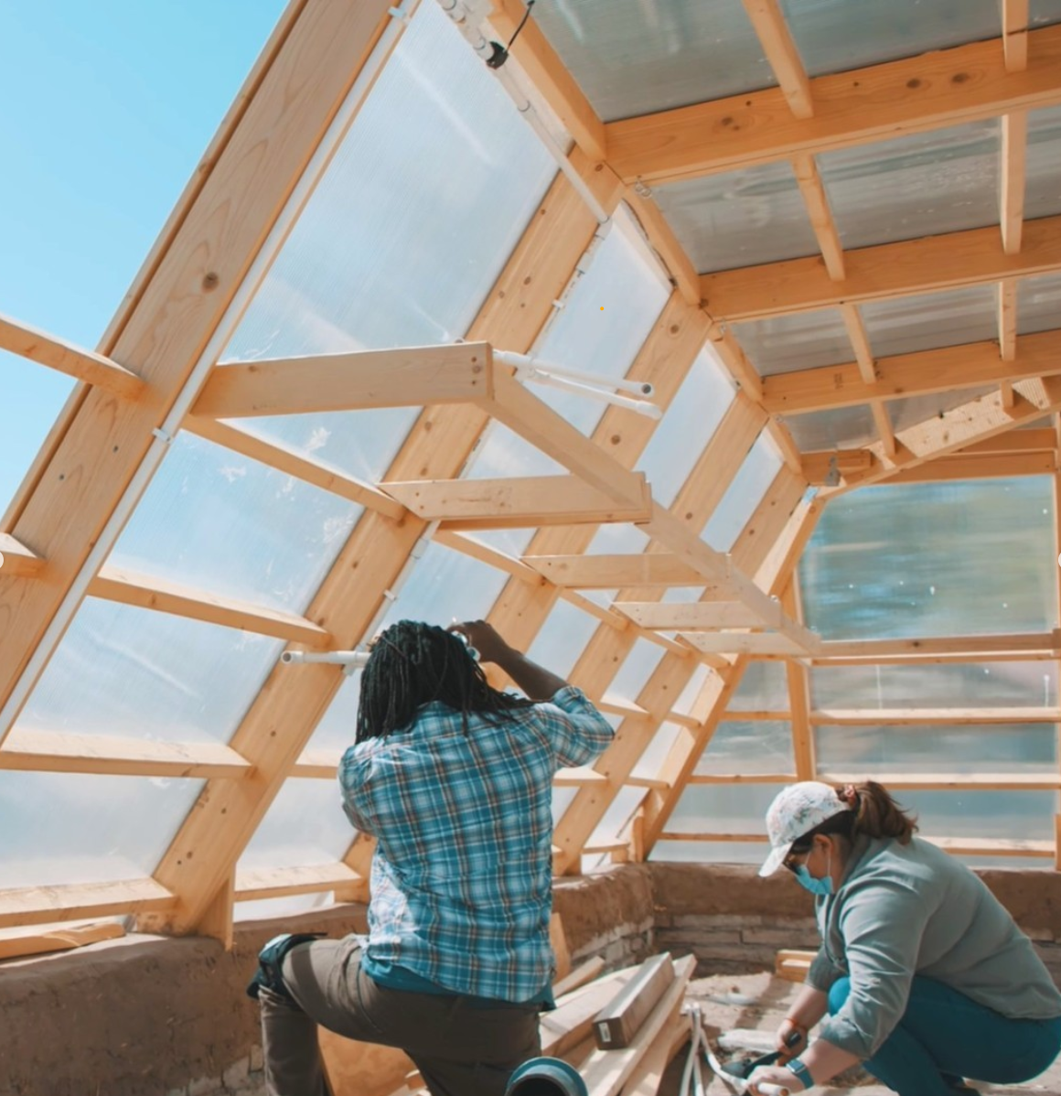
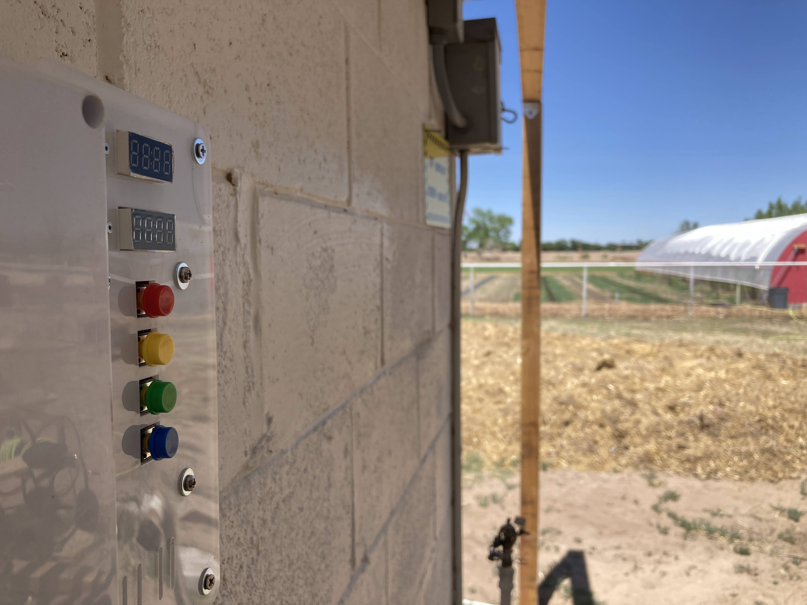
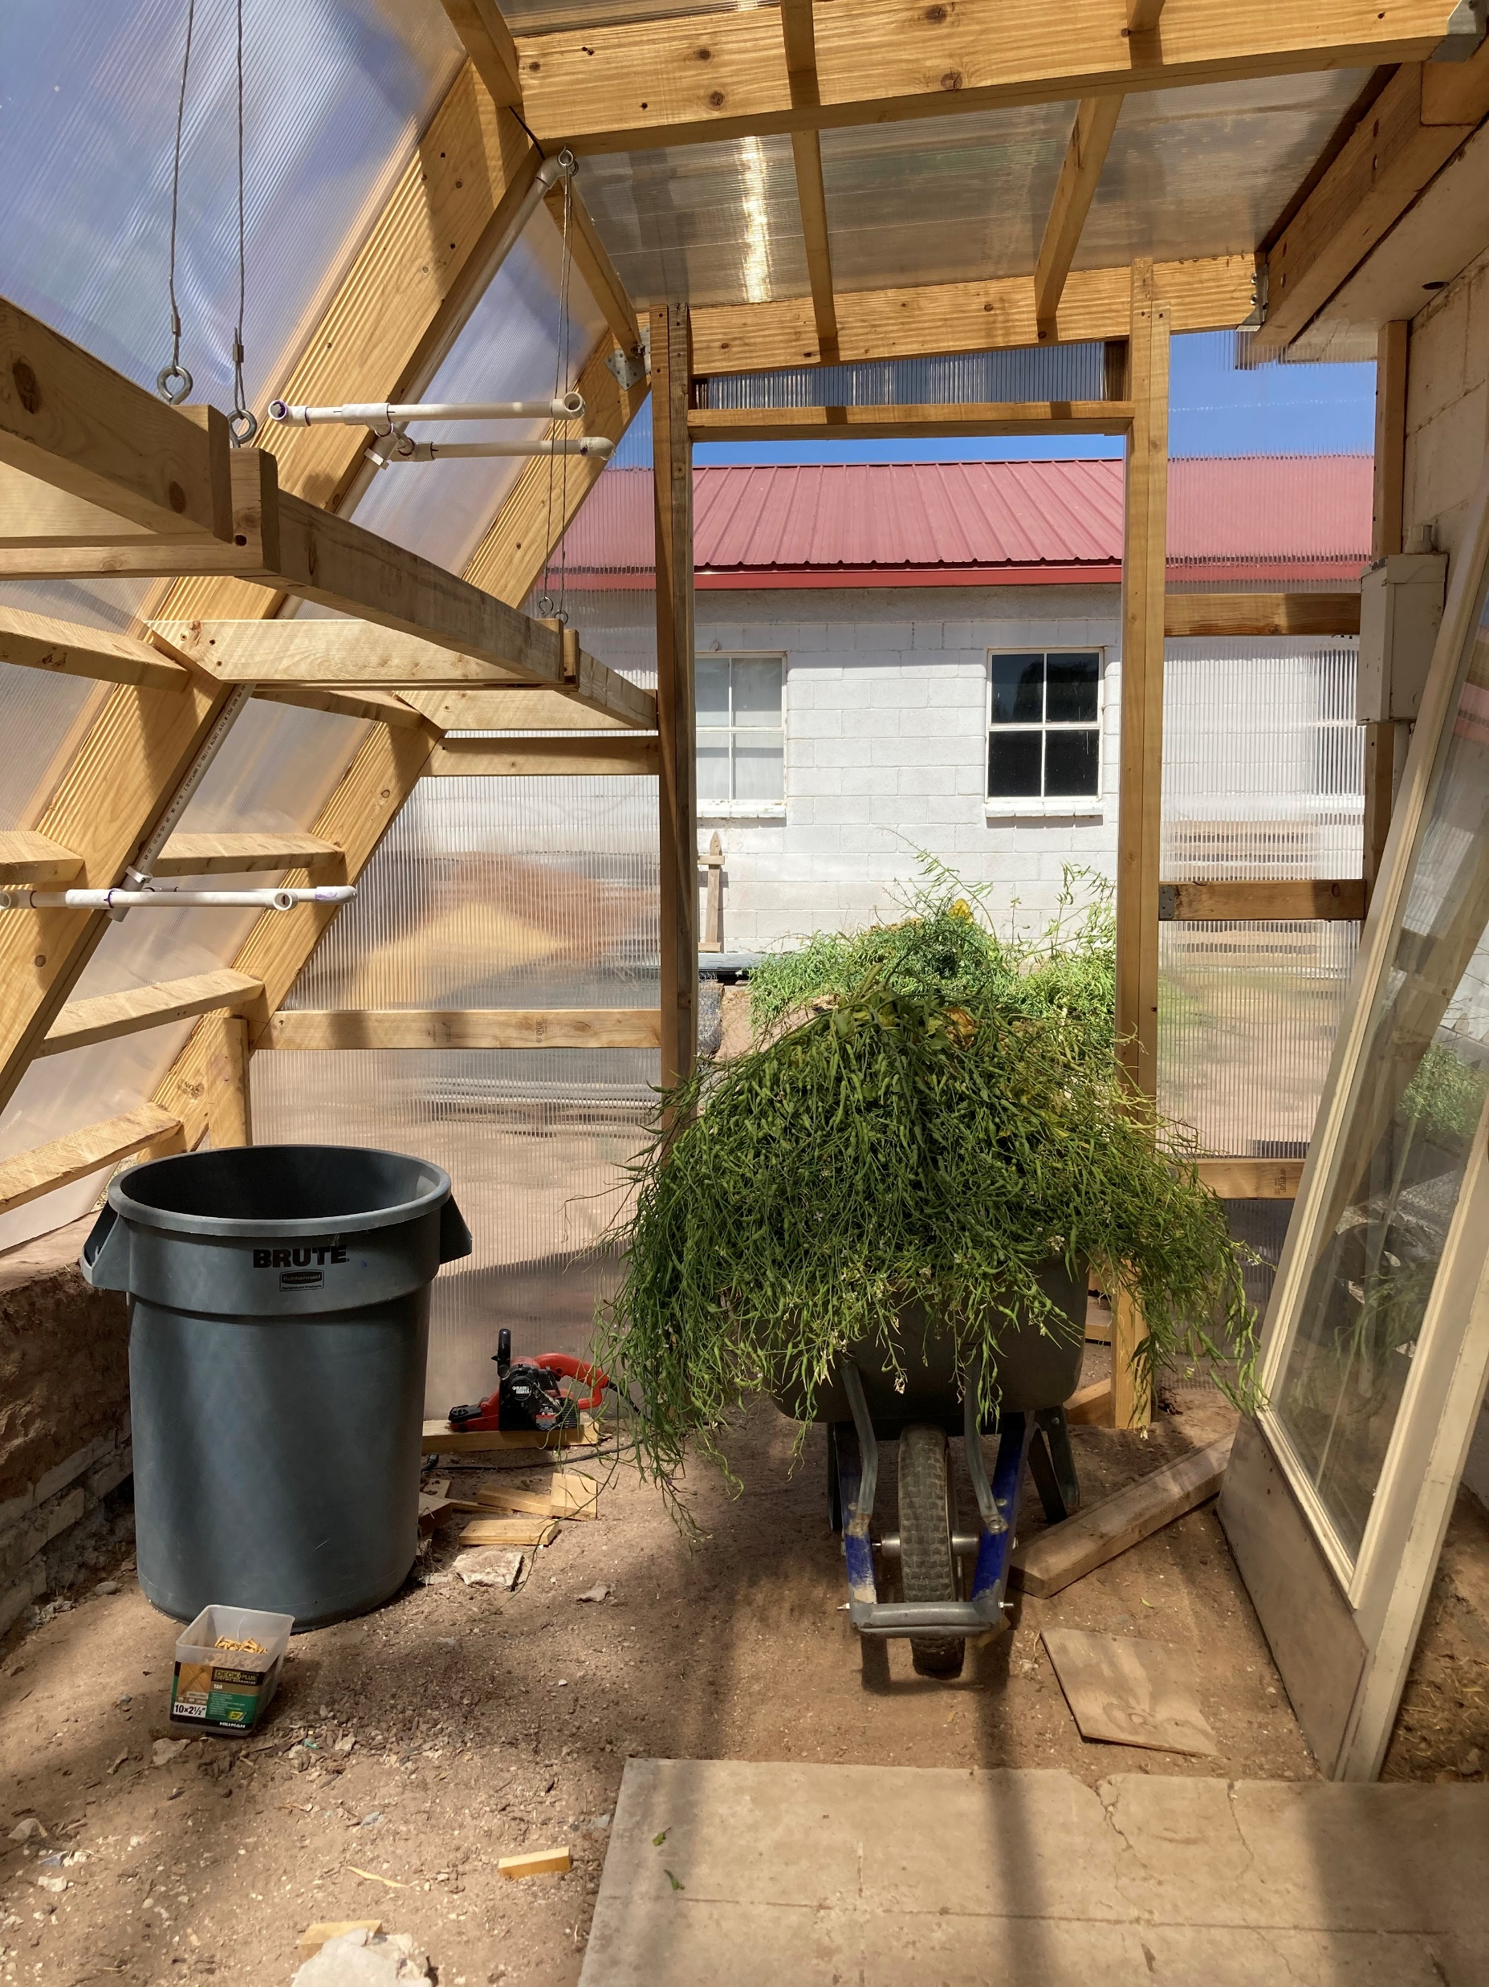
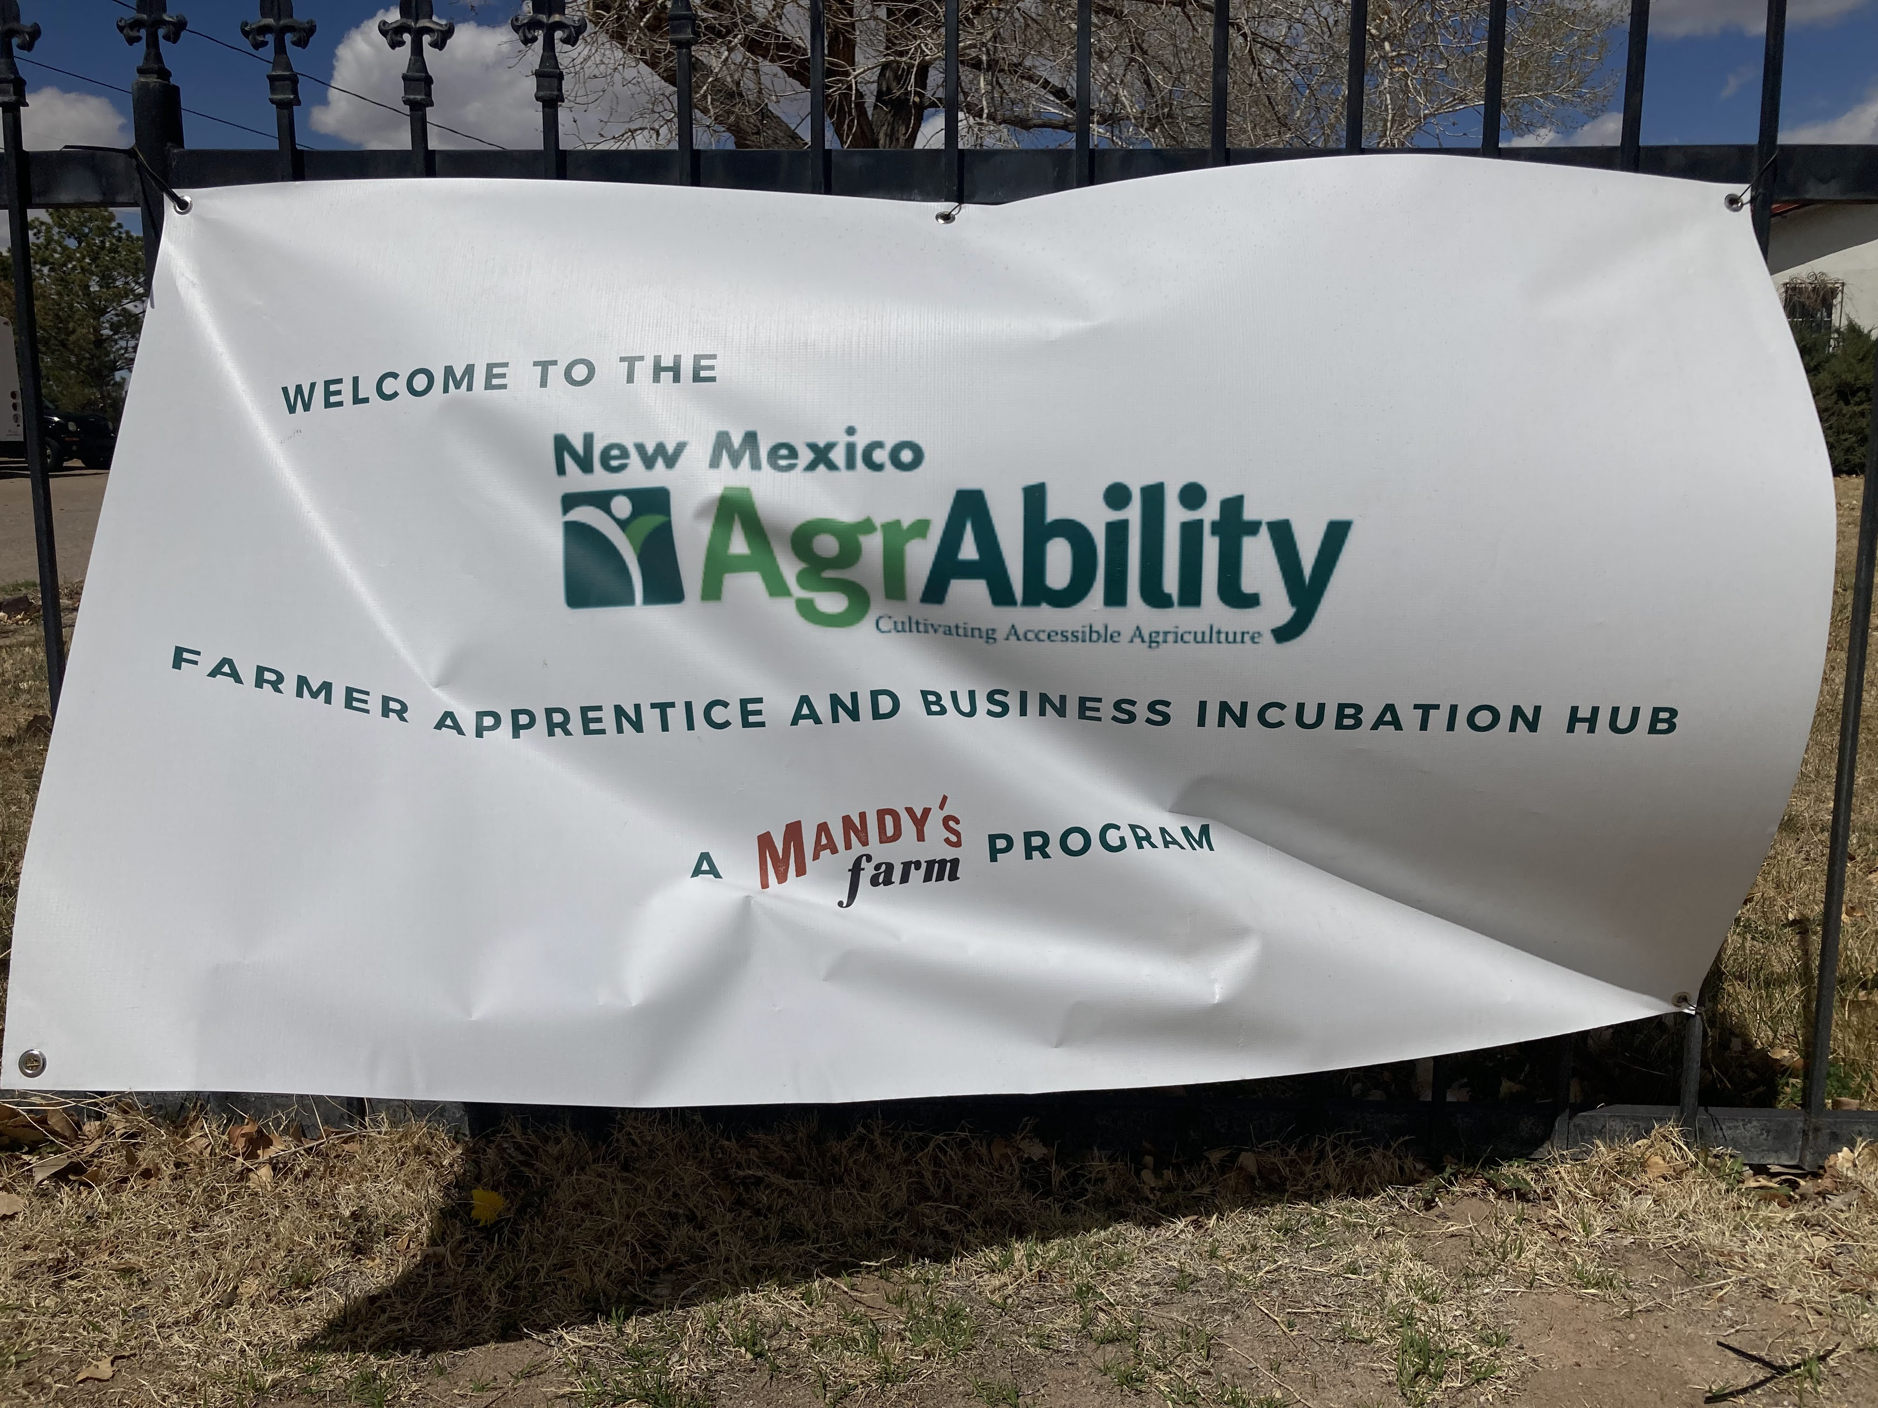
Mandy’s Farm & AgrAbility: Inclusive Agriculture
Mandy’s Farm is a nonprofit organization that assists individuals with Developmental Disabilities to achieve goals by structuring a positive, purposeful and caring environment for living, learning, and working in the community.
The vision of AgrAbility is to enhance quality of life for farmers, ranchers, and other agricultural workers with disabilities, so that they, their families, and their communities continue to succeed in rural America
Mandy’s Farm is a project partner of the first AgrAbility Program based in the State of New Mexico, as well as the first AgrAbility Program, nationally, to focus on individuals with intellectual and developmental disabilities.

Slide 5
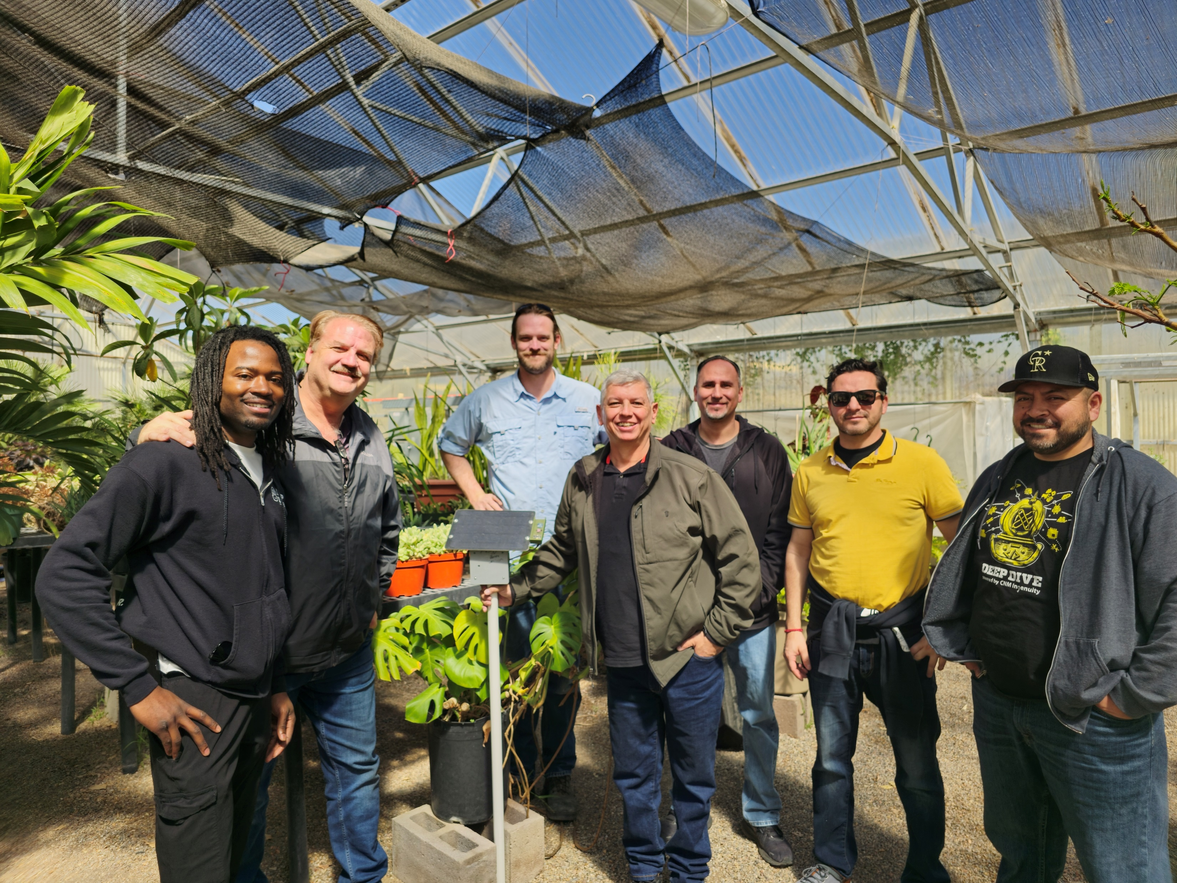
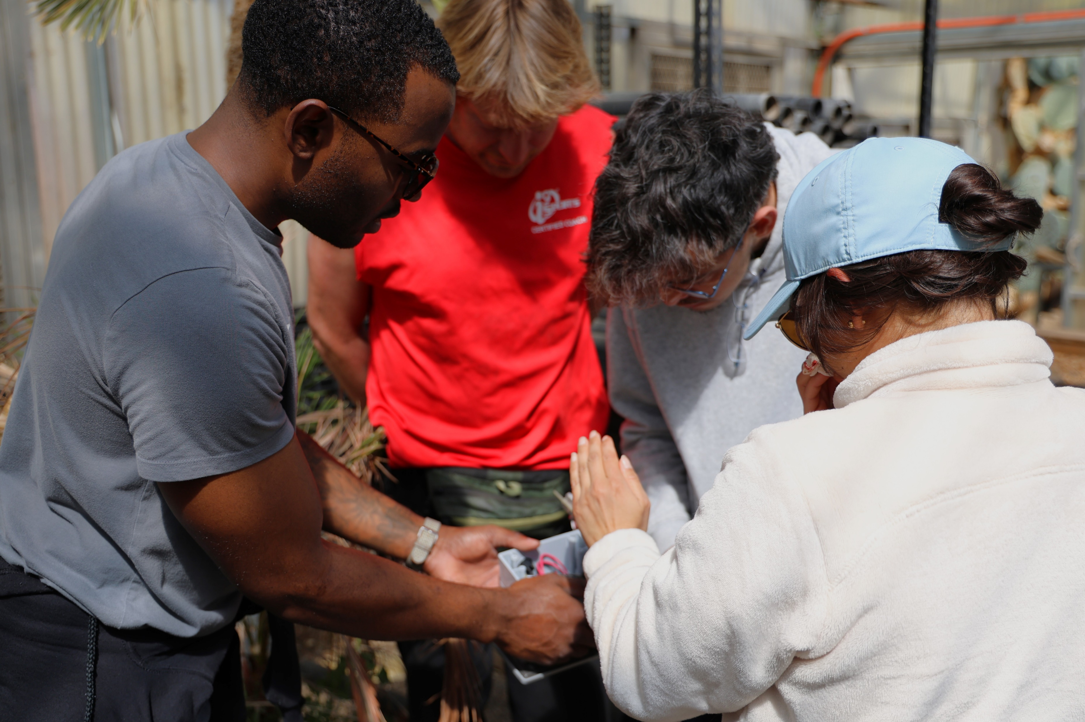
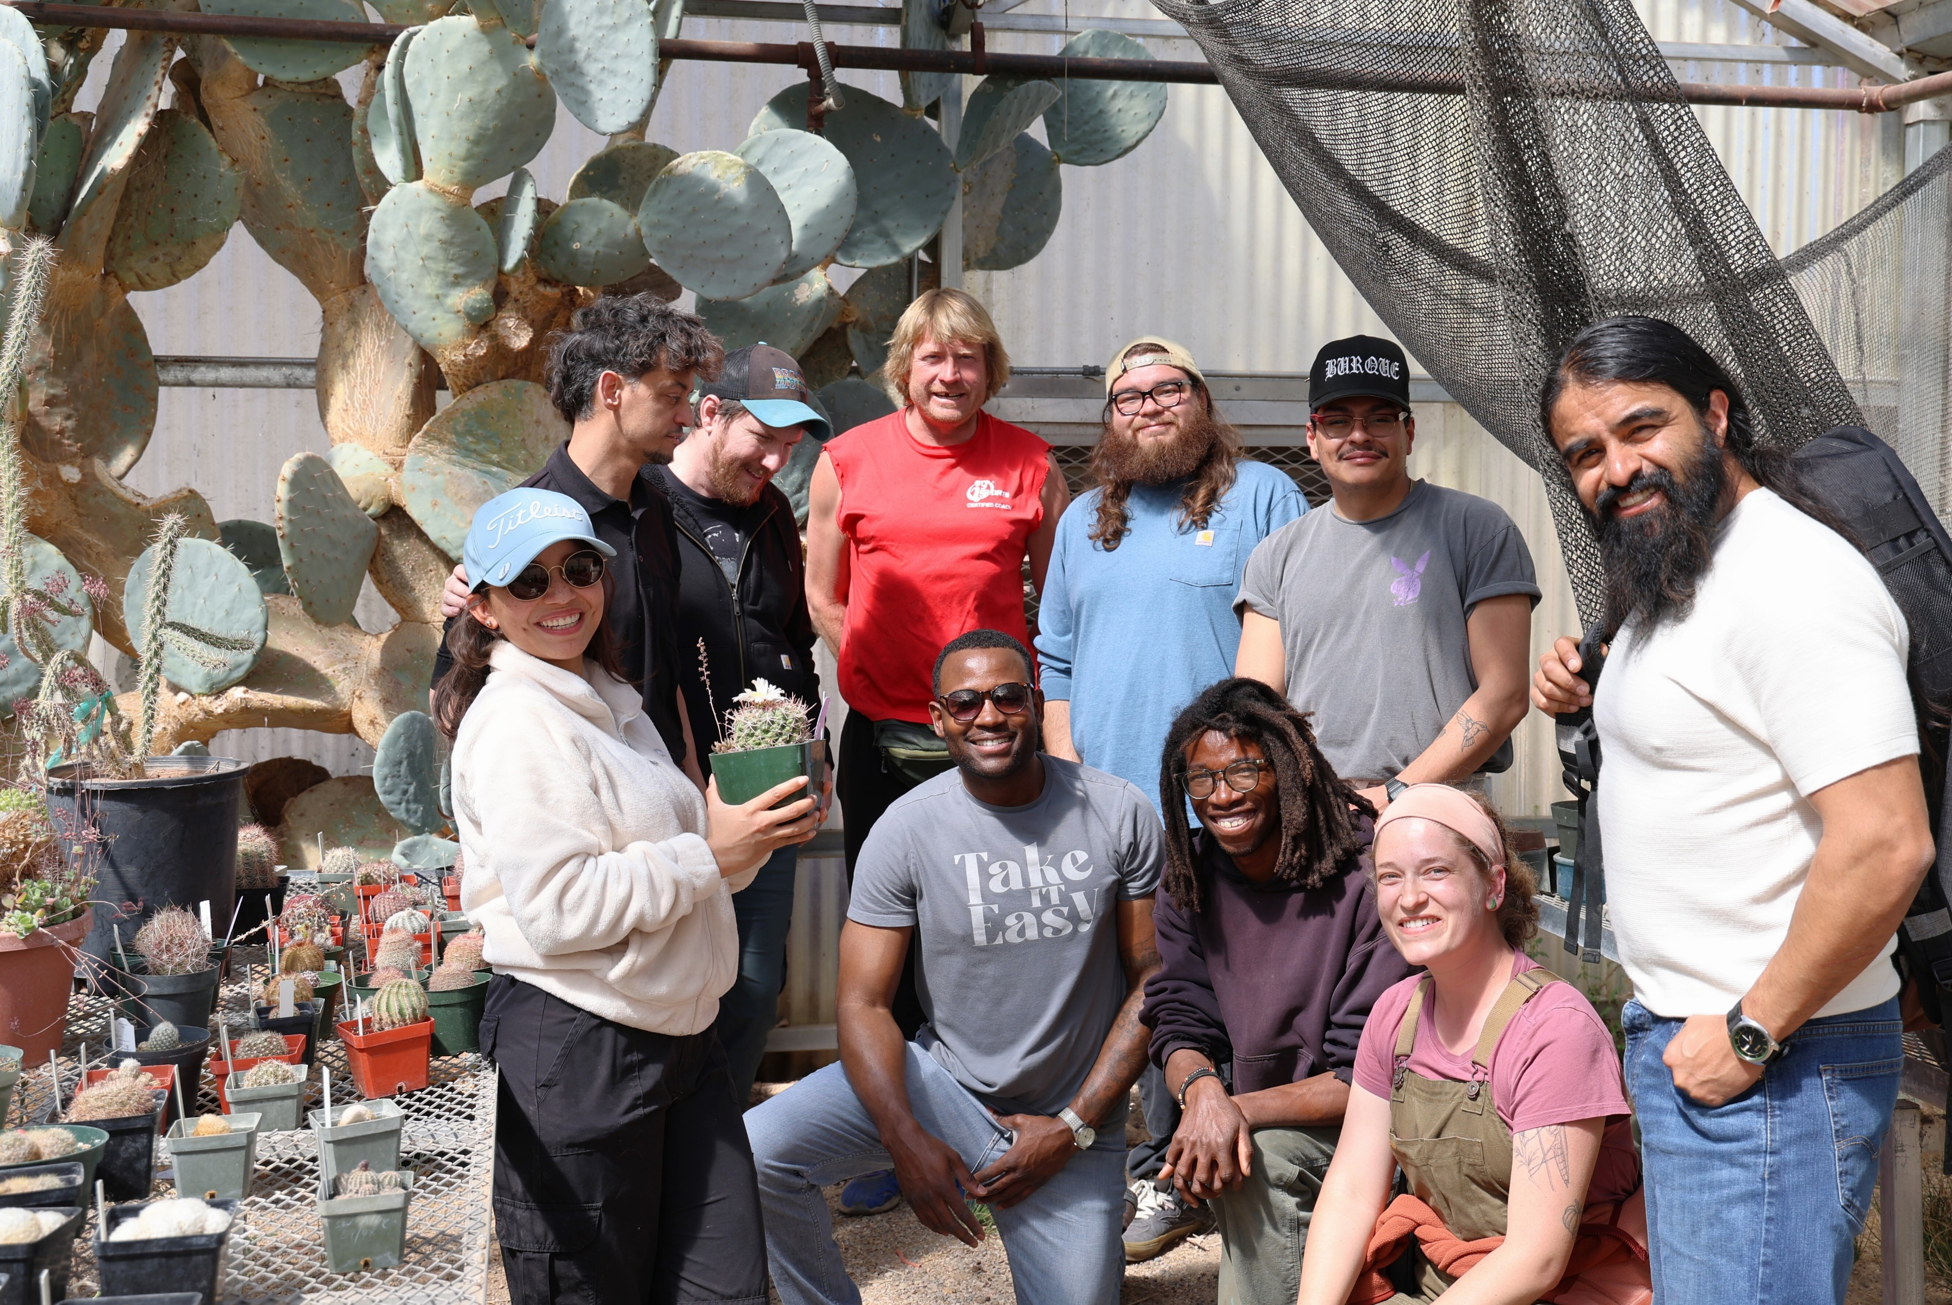
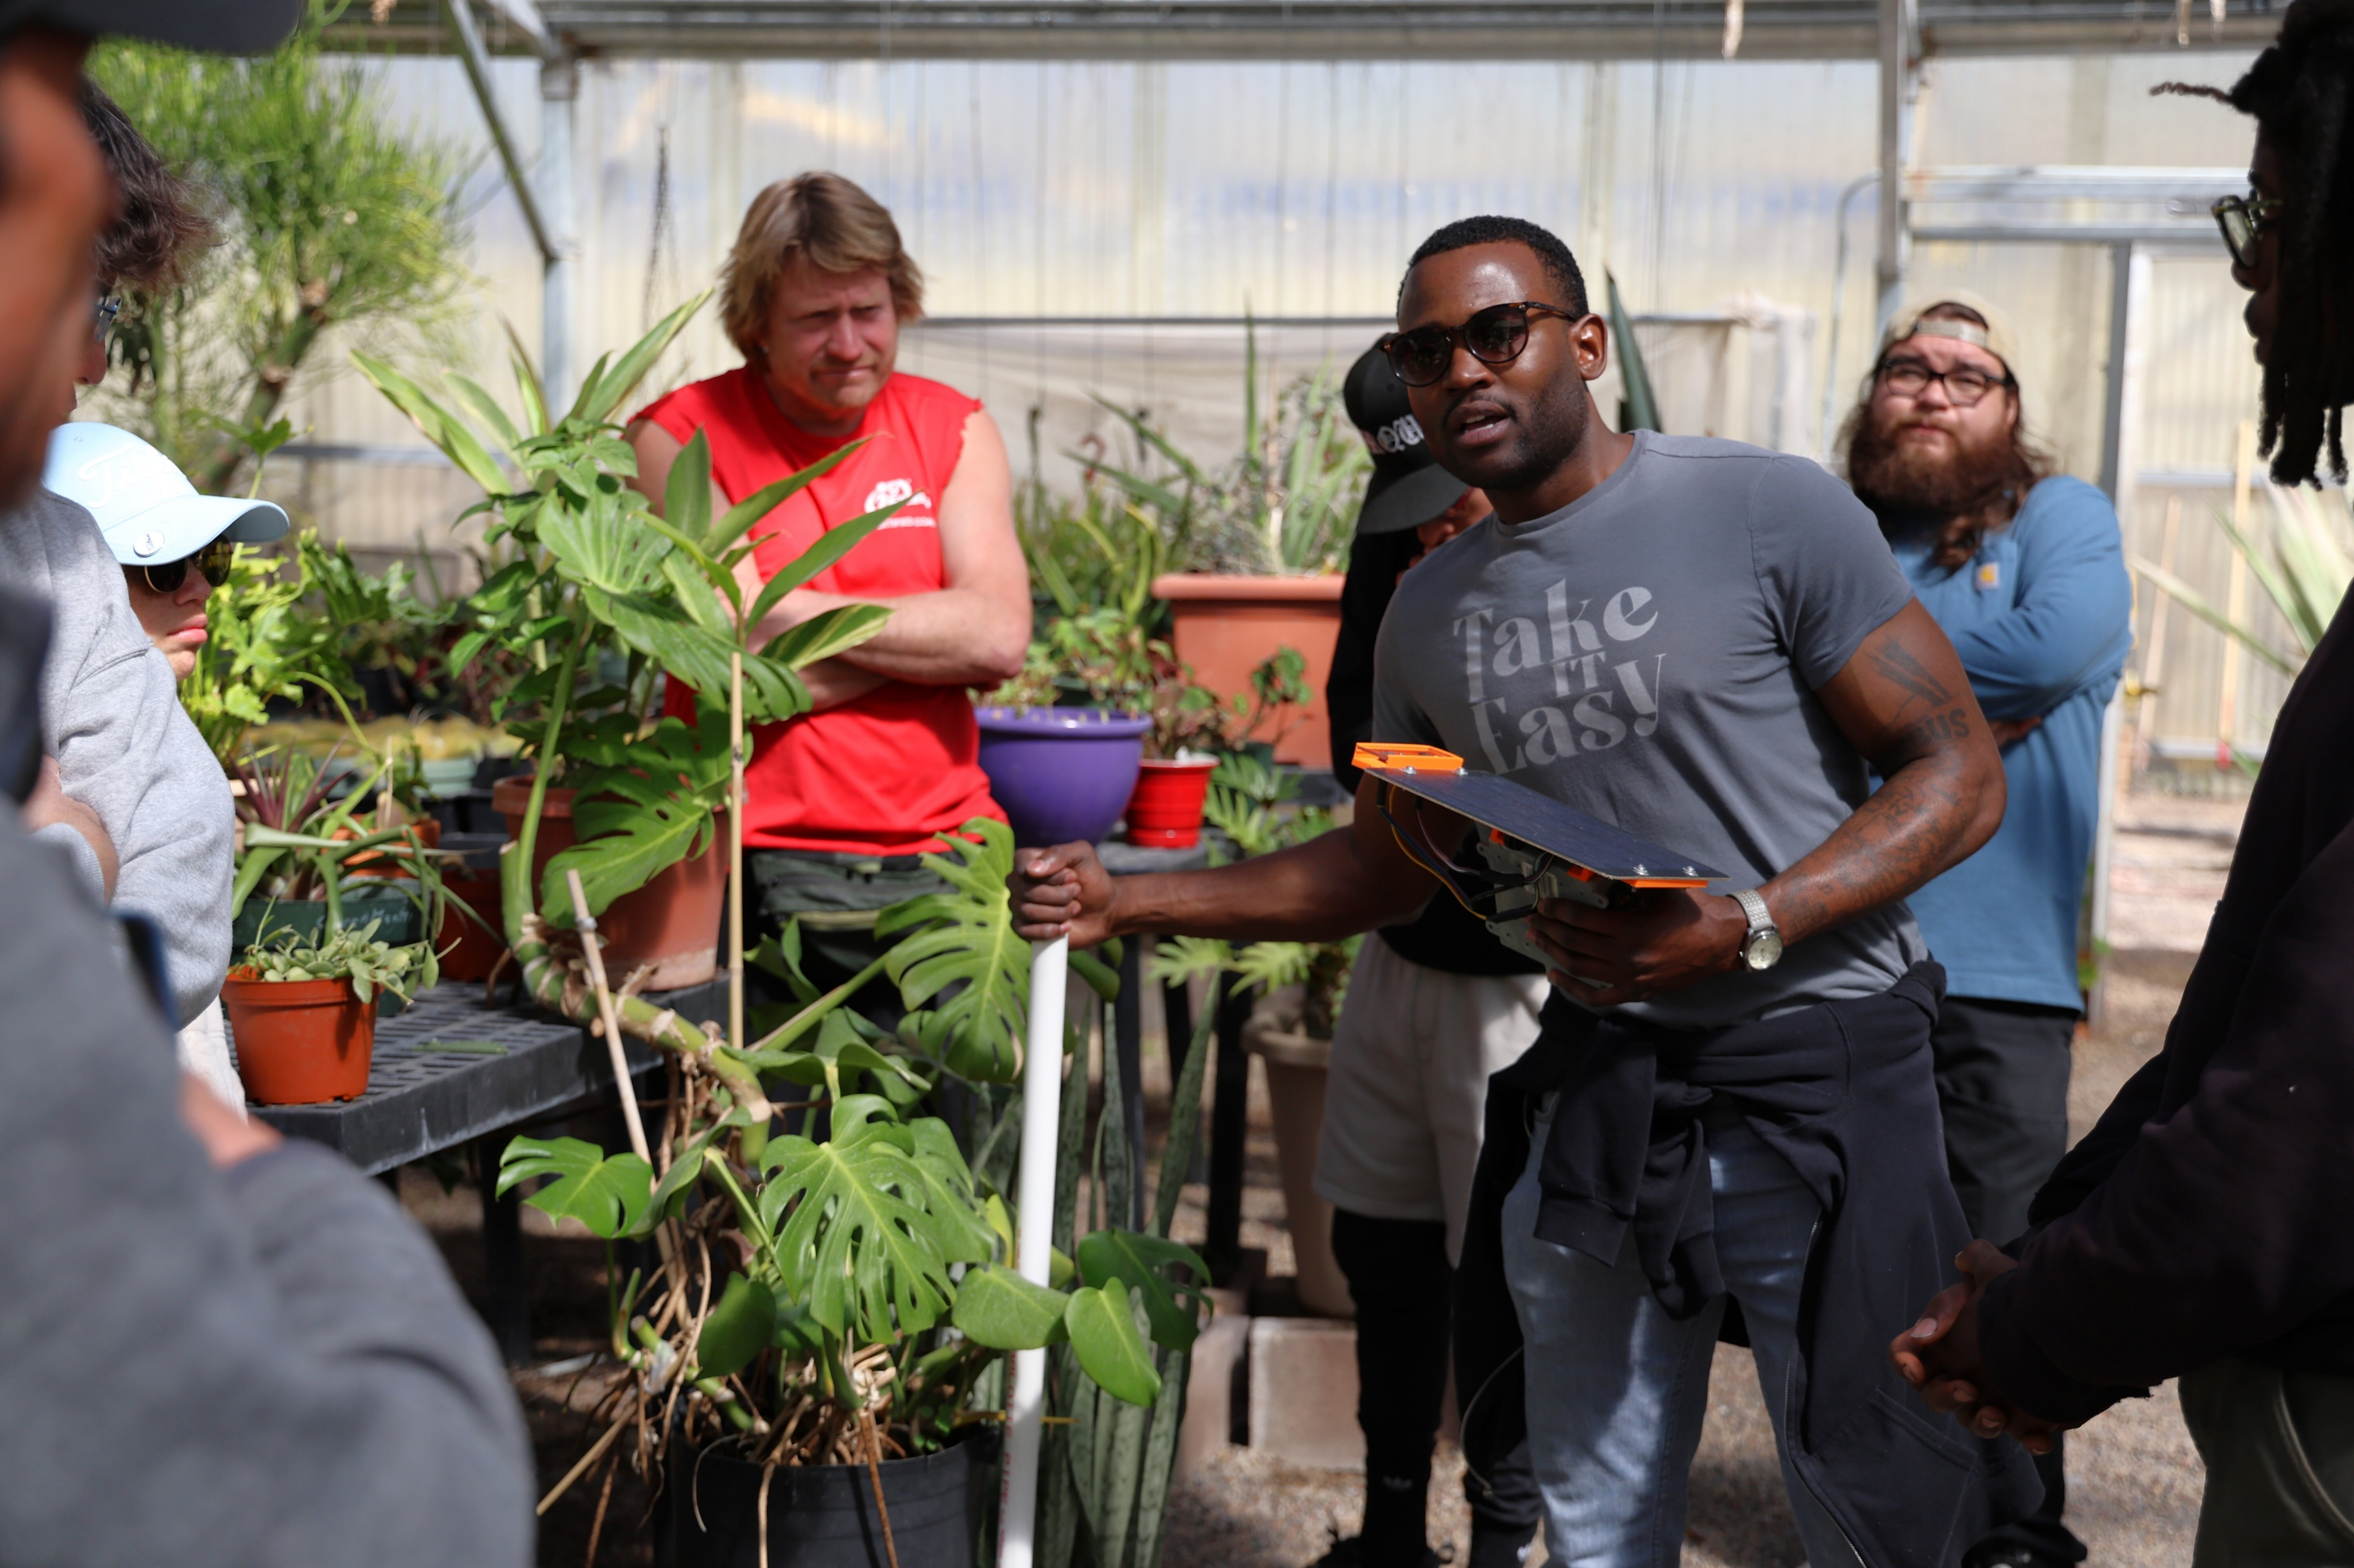
ABQ Biopark Teams Up With IoT Graduates
The ABQ BioPark is a living environmental park that protects the natural world and connects communities with nature. It is a refuge for thousands of animals and plants cared for by zoological, marine and botanical experts who lead significant science-based conservation work in New Mexico and around the world.
Since 2023 CNM's Technology Solutions Lab has worked closely with the horticulturist and master gardeners to implement IoT technology in their greenhouses to improve productivity and data driven decision making. Smart devices that measure temperature, humidity, barometric pressure, and not only the amount of light present but also the amounts of light within different wavelengths are currently providing the ABQ Biopark with invaluable information.

Slide 6
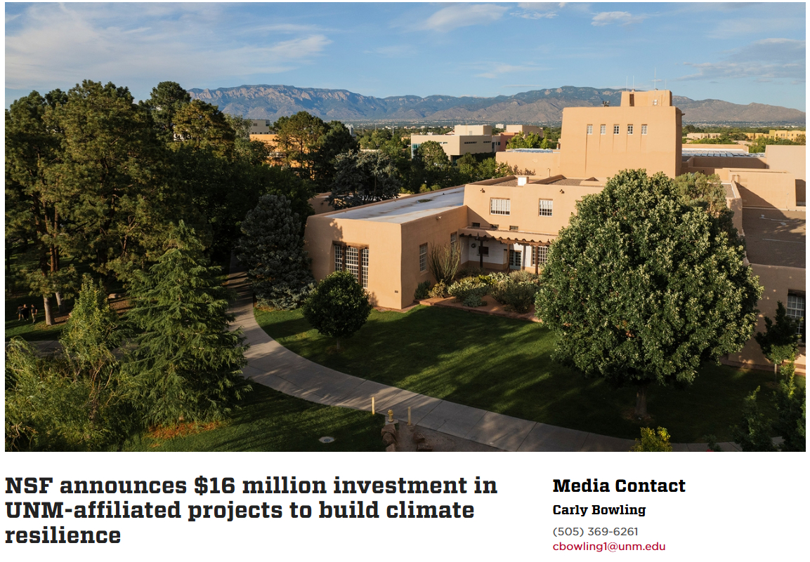
UNM’s Role In Building Climate Resilience
The National Science Foundation has recently announced it will invest roughly $78 Million in projects that will build climate resilience capacity. From that $78 million, nearly $16 million will fund three research projects led or supported by The University of New Mexico.
UNM will work collaboratively with other institutions to comprehend the impacts of indoor farming and combine Indigenous knowledge with Western science.
UNM will lead the project’s core socio-economic work, investigating the drivers and impacts of controlled environment agriculture on tribal communities.
Working closely with the tribal communities, the team will learn what elements of the project are most relevant to individual communities.
An 8-week summer research experience in engineered agriculture will be offered by UNM starting in 2025 which will provide exciting opportunities for learning and allow for the development of tailored controlled environment agriculture systems and a climate-smart and community-based workforce.

Slide 7
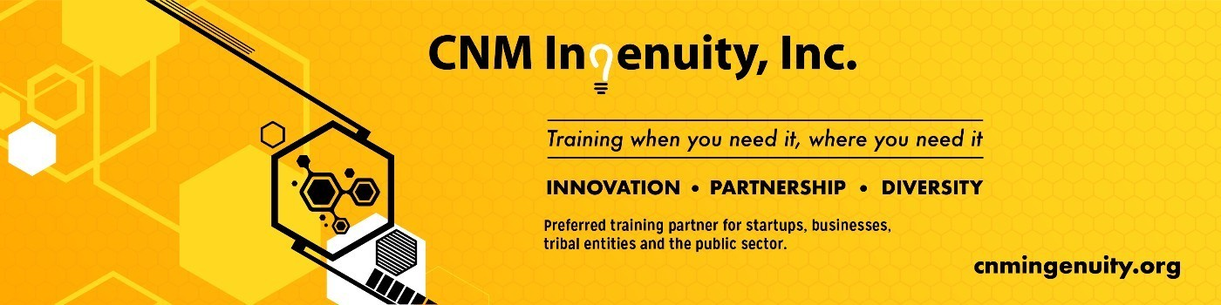
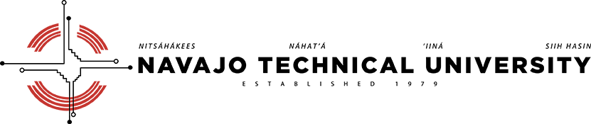
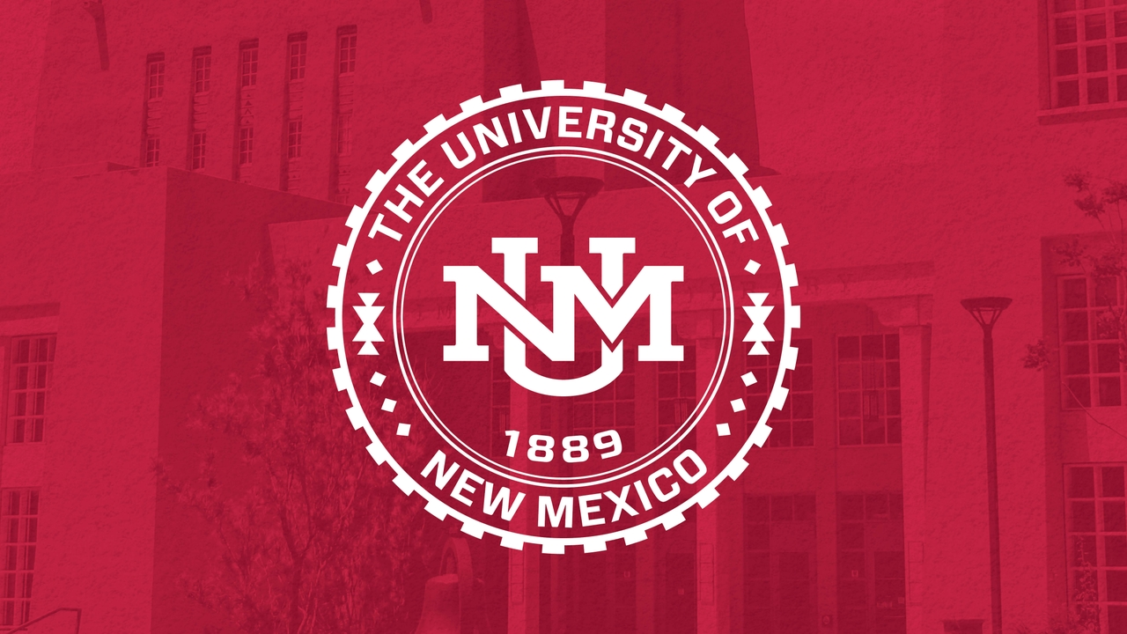
Resilient Futures
CNM’s IoT bootcamp specializes in training a highly skilled workforce prepared to enter and thrive in the technology field. CNM's Technology Solutions Lab will be creating training material that will be used in the 8-week summer program hosted by UNM, and providing Internet of Things technology that will be used to conduct research in indoor farming.
The collaborations between CNM, regional tribal communities, UNM, and other institutions continue to drive innovation and advocate for equity.

Slide 8
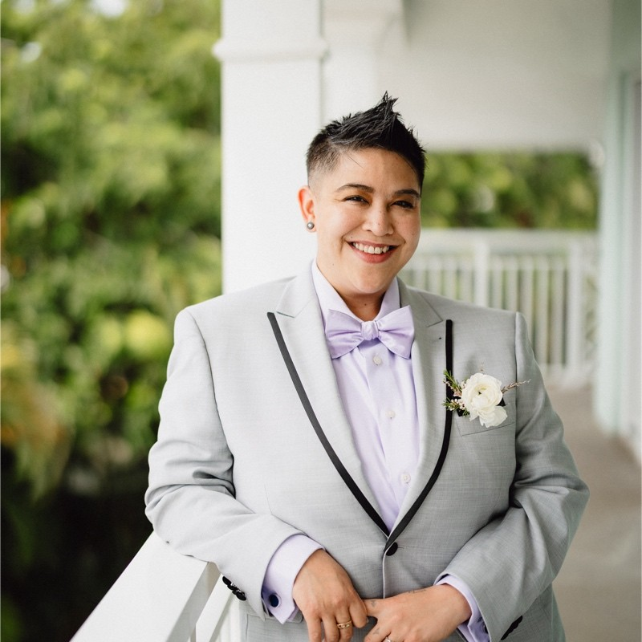
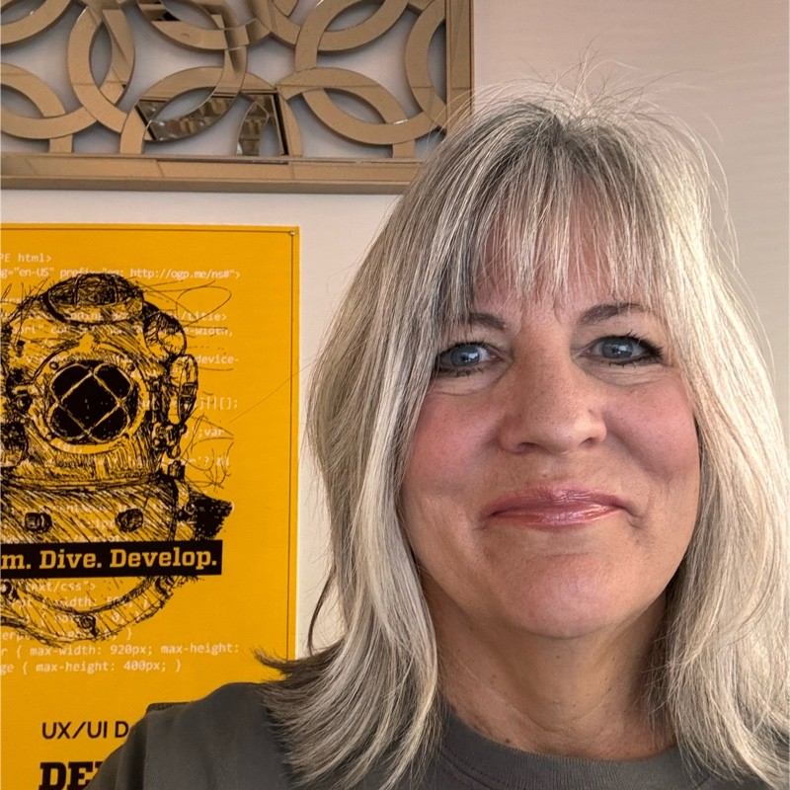
Contact Us:
Learn more about the IoT bootcamp
https://deepdivecoding.com/iot/
Jamie Dowden-Duarte
Assistant Instructor – IoT
https://www.linkedin.com/in/embeddedcodingjamiedowdenduarte/
Monica Olmstead
Senior Program Manager – Deep Dive
https://www.linkedin.com/in/monica-olmsted-059349a9/

